Slide 1
Preservation & Recapitalization Strategies Without Tax Credits
National Housing & Rehabilitation Association
2017 Annual Meeting & Symposium
Chris Herrmann, Vice President
(212) 284-7191 / cherrmann@enterprisecommunity.com

Slide 2
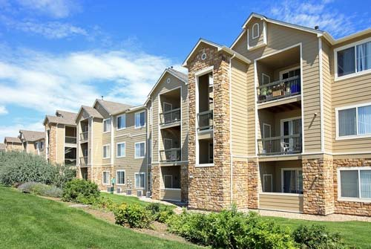
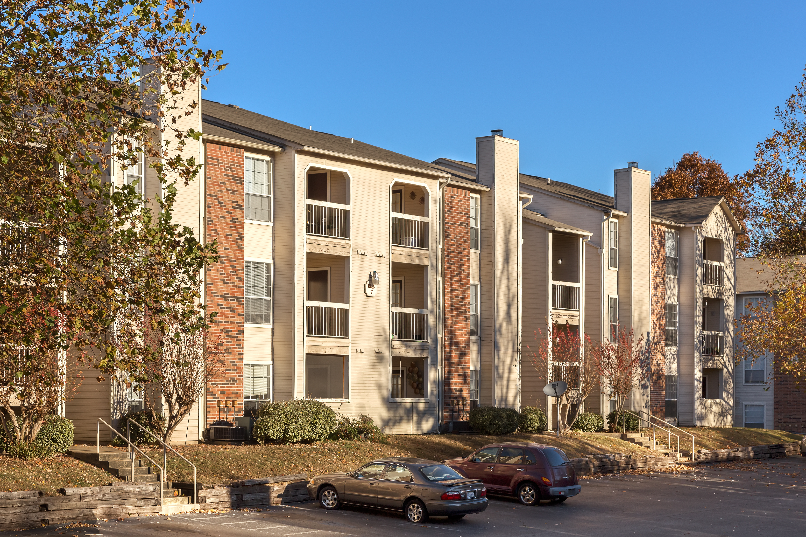
Enterprise’s Conventional Equity Product
Enterprise began offering “conventional equity” as an extension of our LIHTC syndication business in 2014.
Through this business, we joint venture with local partners to acquire, improve, and create value in affordable and workforce rental housing properties.
We invest in Year 10+ LIHTC, Section 8, and market rate / naturally affordable properties at or below 80% of AMI.
To date we have acquired nearly $200 MM of multifamily real estate, comprised of 13 properties and 2,500 homes.
2

Slide 3
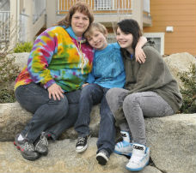
Where Enterprise’s Conventional Equity Works Best
Total acquisition budget of $7.5 - $50 million.
Year 1 capitalization rate of roughly 6% or greater.
Modest value add opportunities (improved management, light interior rehab, energy retrofit, and/or tax abatement).
Willingness to consider GP interest acquisitions.
We invest in everything from 1-year “bridge-to-resyndications” to 7-year buy-and-hold strategies, and through either pari-passu or preferred equity structures.
Unique opportunities in the current market environment.
3

Slide 4
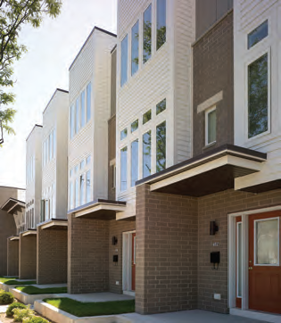
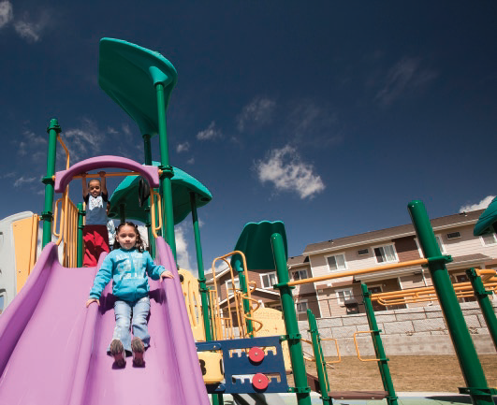
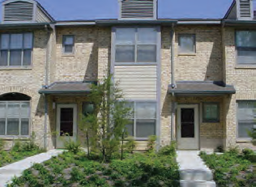
Sample Conventional Equity Investment
4

