Slide 1





Moderator
Chris Jones, Chief Executive Officer
Housing Opportunities Unlimited
Panelists
Jamar Adams, Founder and Chief Executive Officer
Essence Development
Susan Connelly, Chief Operating Officer
Housing Opportunities Unlimited
Jaissa Feliz, Development Director
Beacon Communities
Cathy Hoog, Executive Director
Salem and Marblehead Housing Authorities
Resident Relocation:
What Does it Mean for Your Redevelopment Projects?

Slide 2
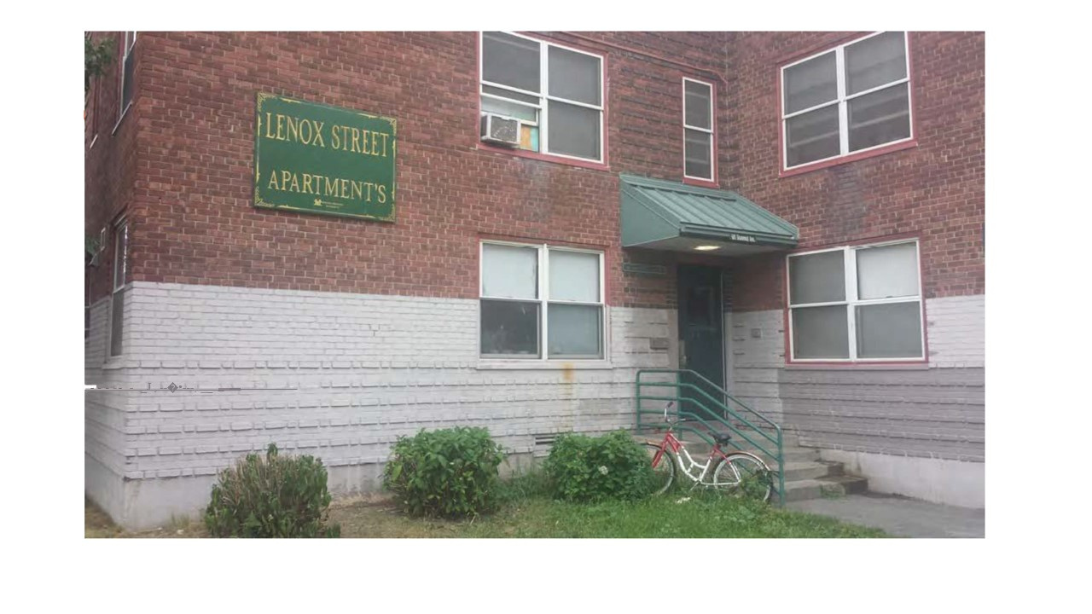
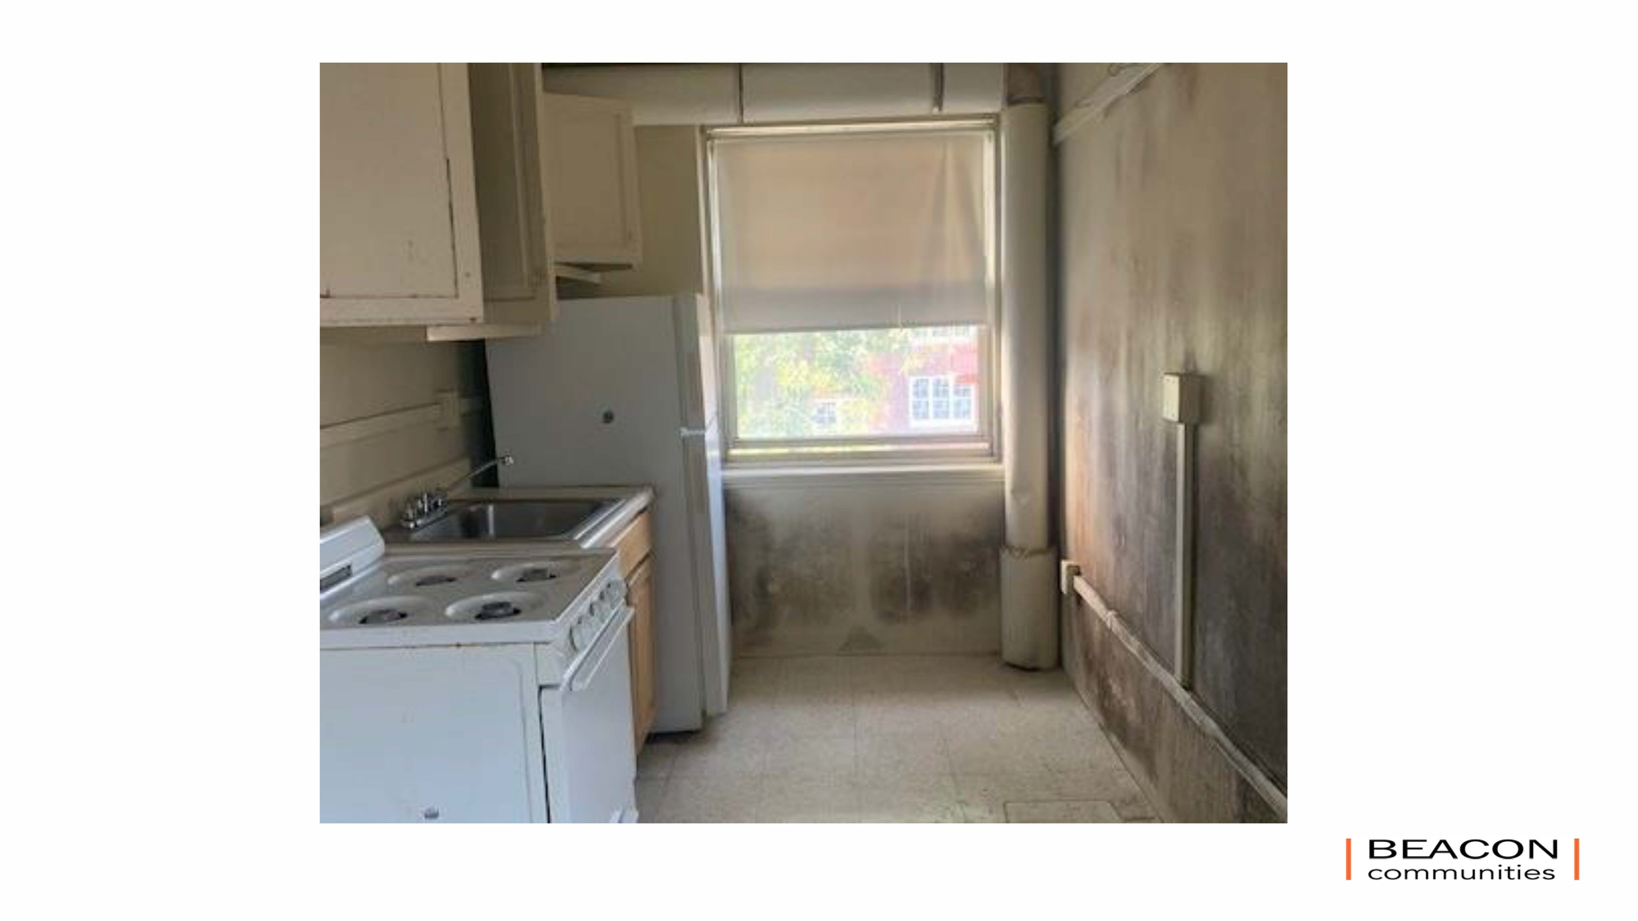
Resident Relocation: What Does it Mean for Your Redevelopment Projects?
LENOX STREET APARTMENTS - BOSTON, MA
Public/Private Partnership: Boston Housing Authority and Beacon Communities
PROJECT FACTS
  285 UNITS
  Almost all units are restricted to households earning 50% AMI or below
FUNDING SOURCES
  BHA PBV Section 8 vouchers
  MassHousing First Mortgage
  Federal Low-Income Tax Credits
  Federal Historic Tax Credits
RELOCATION REGULATION REQUIREMENTS
  URA

Slide 3


Resident Relocation: What Does it Mean for Your Redevelopment Projects?
LENOX STREET APARTMENTS - BOSTON, MA
Public/Private Partnership: Boston Housing Authority and Beacon Communities
PROJECT FACTS
  285 UNITS
  Almost all units are restricted to households earning 50% AMI or below
FUNDING SOURCES
  BHA PBV Section 8 vouchers
  MassHousing First Mortgage
  Federal Low-Income Tax Credits
  Federal Historic Tax Credits
RELOCATION REGULATION REQUIREMENTS
  URA

Slide 4
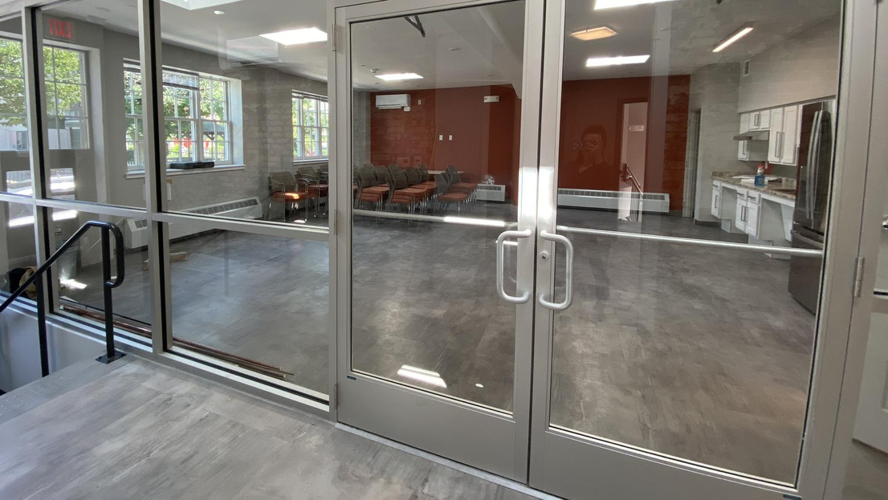

Resident Relocation: What Does it Mean for Your Redevelopment Projects?
LENOX STREET APARTMENTS - BOSTON, MA
Public/Private Partnership: Boston Housing Authority and Beacon Communities
PROJECT FACTS
  285 UNITS
  Almost all units are restricted to households earning 50% AMI or below
FUNDING SOURCES
  BHA PBV Section 8 vouchers
  MassHousing First Mortgage
  Federal Low-Income Tax Credits
  Federal Historic Tax Credits
RELOCATION REGULATION REQUIREMENTS
  URA

Slide 5
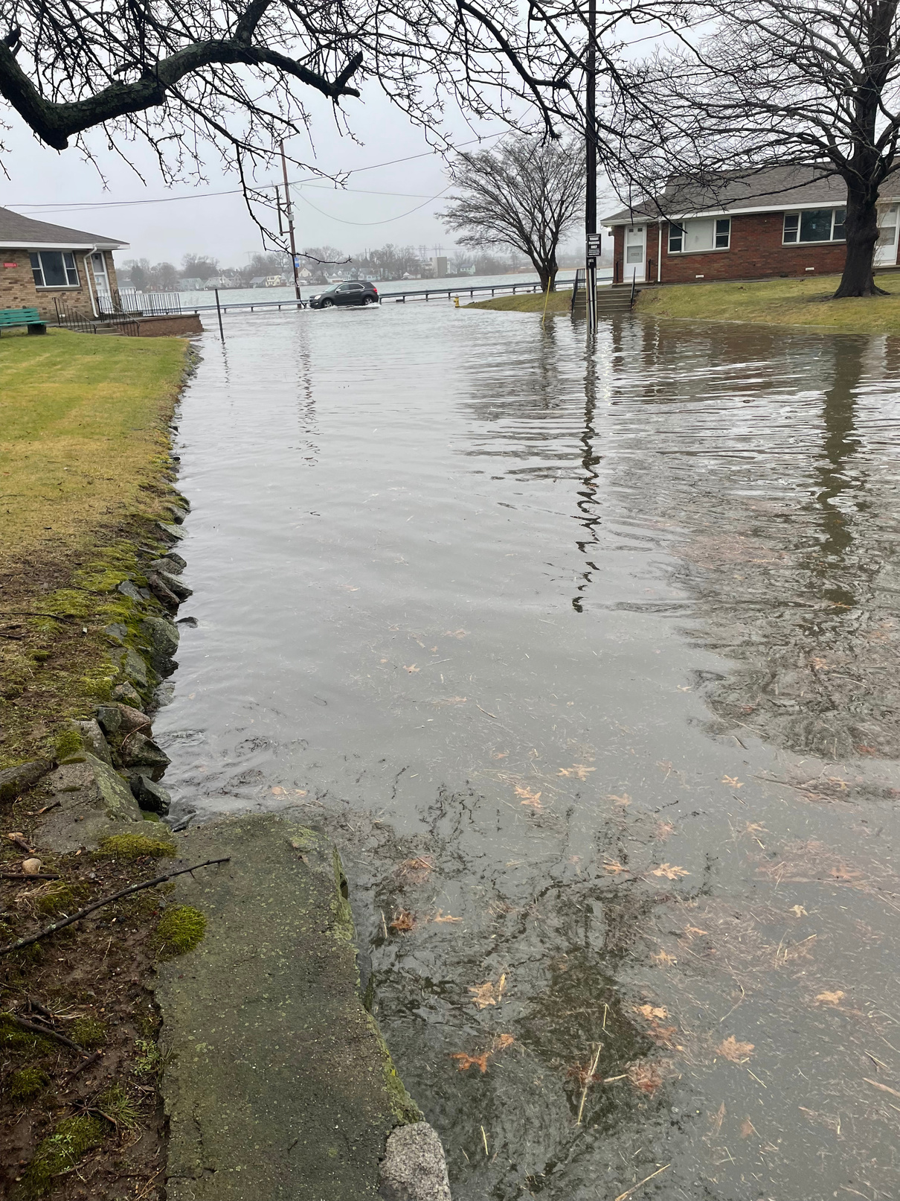
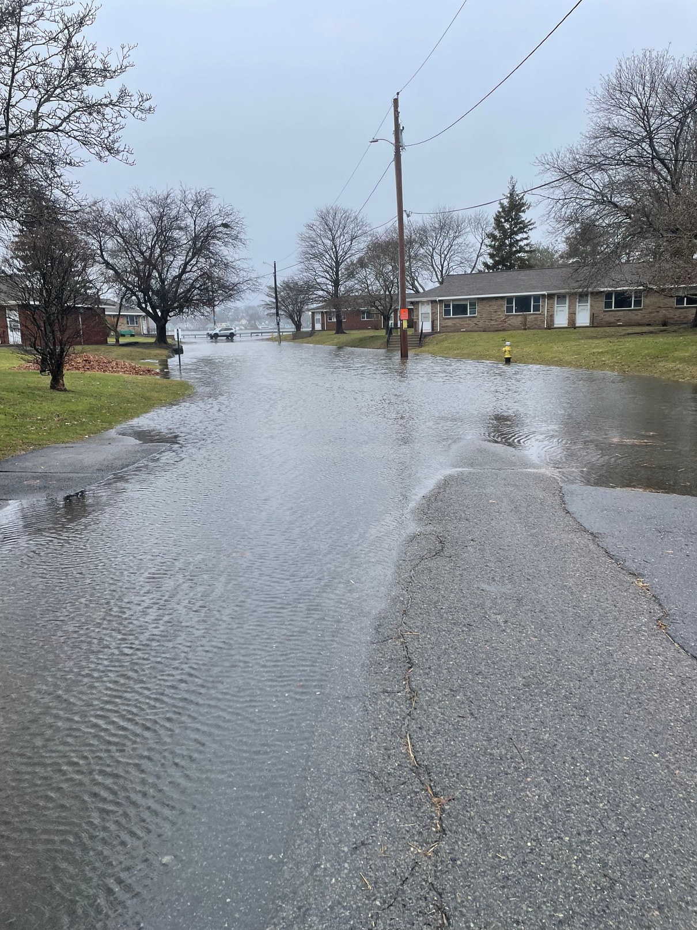
Resident Relocation: What Does it Mean for Your Redevelopment Projects?
LEEFORT TERRACE - SALEM, MA
Public/Private Partnership: Salem Housing Authority and Beacon Communities
PROJECT FACTS
  124 UNITS
  Almost all units are restricted to households earning 50% AMI or below
FUNDING SOURCES
  Project Based MRVP
  Federal Low-Income Tax Credits and Historic Tax Credits
  Home Investment Partnerships Program (HOME)
  Local MA funding sources
RELOCATION REGULATION REQUIREMENTS
  URA

Slide 6
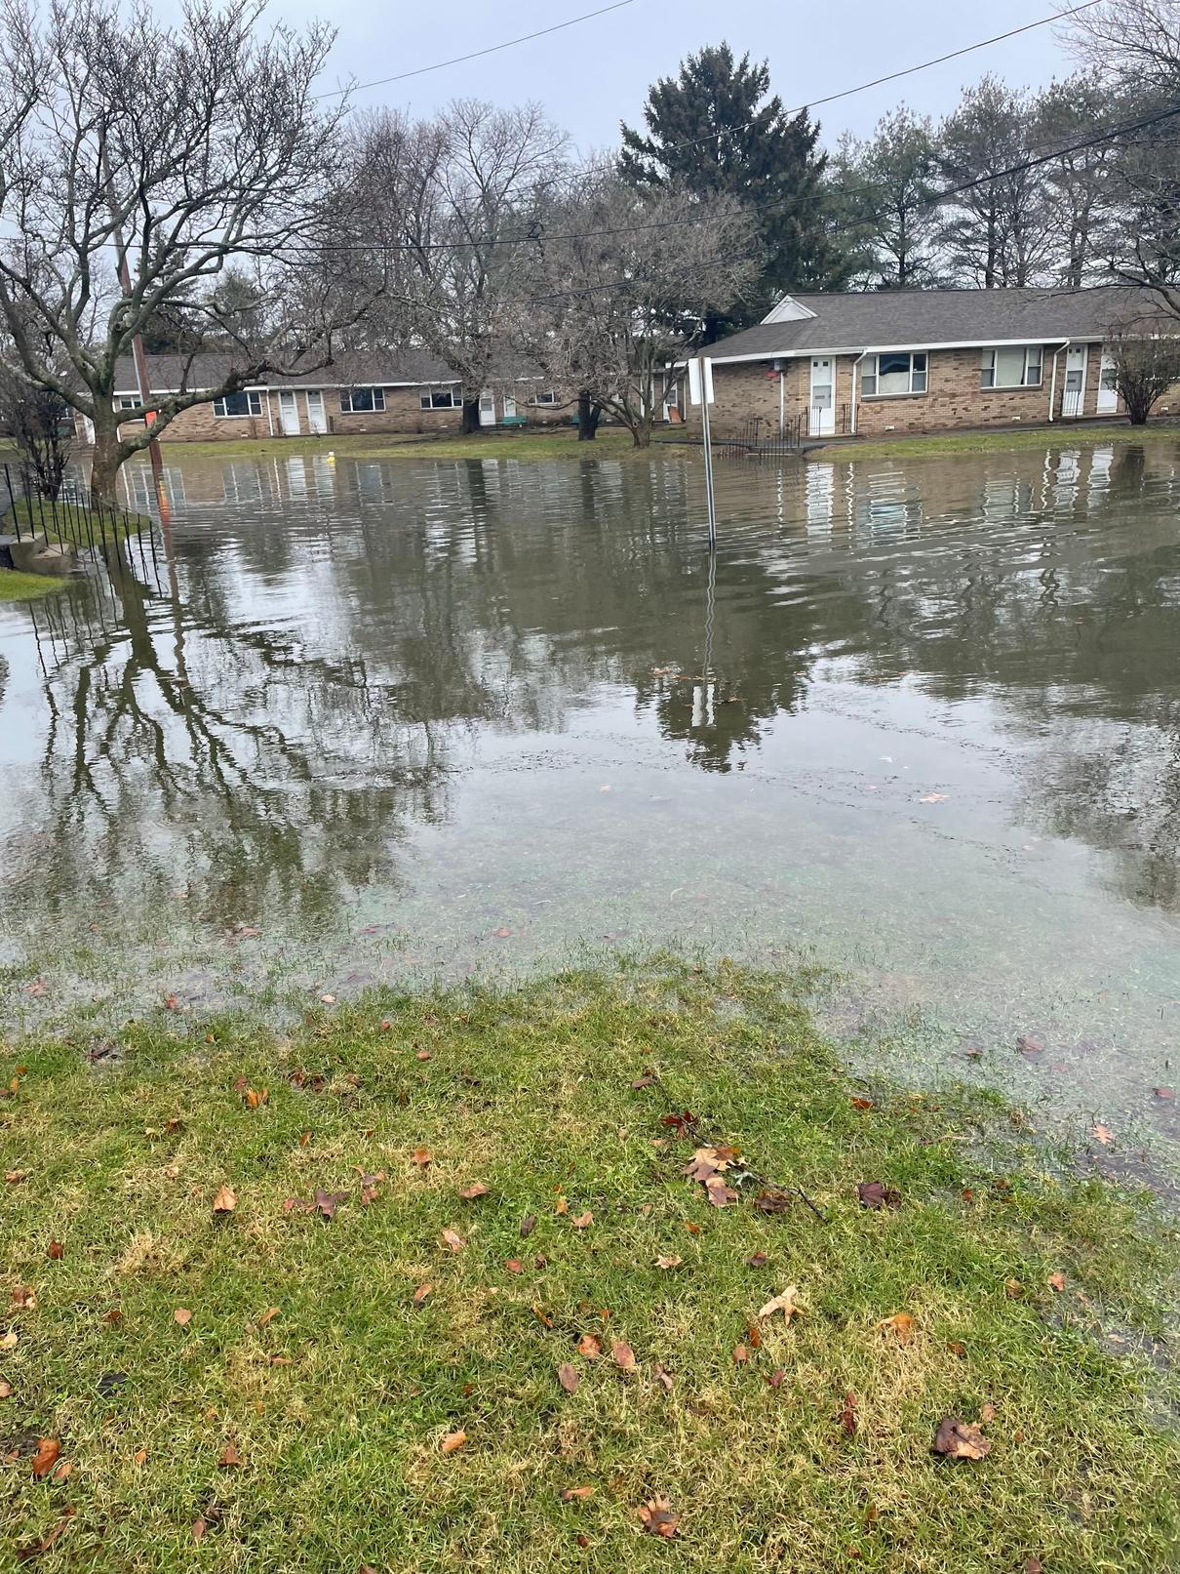

Resident Relocation: What Does it Mean for Your Redevelopment Projects?
LEEFORT TERRACE - SALEM, MA
Public/Private Partnership: Salem Housing Authority and Beacon Communities
PROJECT FACTS
  124 UNITS
  Almost all units are restricted to households earning 50% AMI or below
FUNDING SOURCES
  Project Based MRVP
  Federal Low-Income Tax Credits and Historic Tax Credits
  Home Investment Partnerships Program (HOME)
  Local MA funding sources
RELOCATION REGULATION REQUIREMENTS
  URA

Slide 7


Resident Relocation: What Does it Mean for Your Redevelopment Projects?
LEEFORT TERRACE - SALEM, MA
Public/Private Partnership: Salem Housing Authority and Beacon Communities
PROJECT FACTS
  124 UNITS
  Almost all units are restricted to households earning 50% AMI or below
FUNDING SOURCES
  Project Based MRVP
  Federal Low-Income Tax Credits and Historic Tax Credits
  Home Investment Partnerships Program (HOME)
  Local MA funding sources
RELOCATION REGULATION REQUIREMENTS
  URA

Slide 8
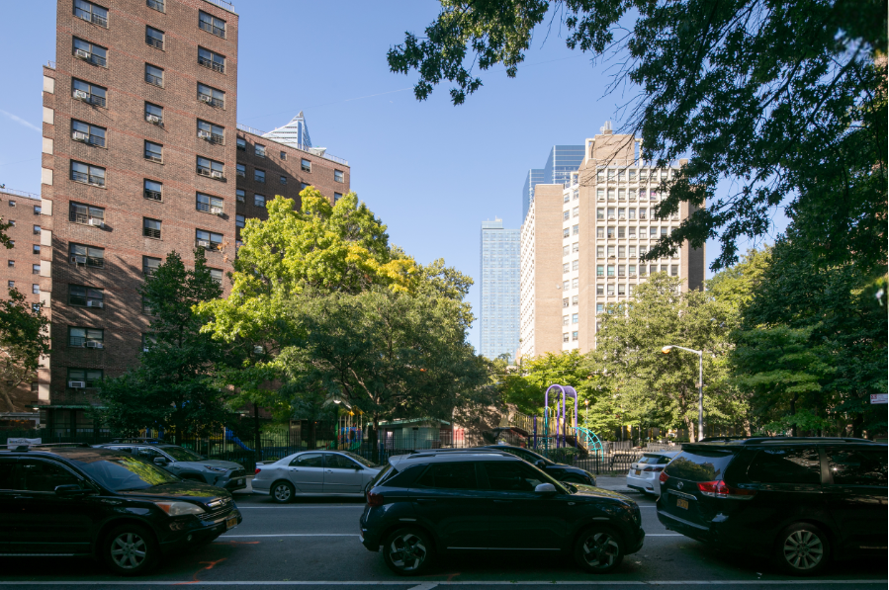

Resident Relocation: What Does it Mean for Your Redevelopment Projects?
FULTON ELLIOTT-CHELSEA HOUSES - MANHATTAN, NY
Public/Private Partnership: New York City Housing Authority and Essence Development and Related Companies
PROJECT FACTS
  2,056 UNITS
  Construction- expected complete
FUNDING SOURCES
  PACT
  Federal Low-Income Tax Credits (LIHTC)
RELOCATION REGULATION REQUIREMENTS
  RAD/Section 18 blend
  URA
  PACT

Slide 9
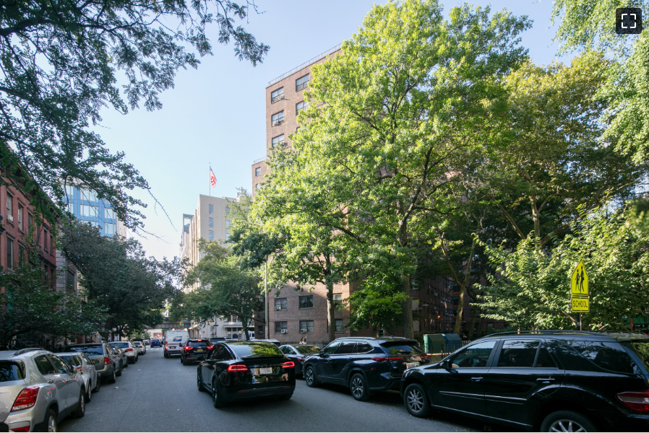

Resident Relocation: What Does it Mean for Your Redevelopment Projects?
FULTON ELLIOTT-CHELSEA HOUSES - MANHATTAN, NY
Public/Private Partnership: New York City Housing Authority and Essence Development and Related Companies
PROJECT FACTS
  2,056 UNITS
  Construction- expected complete
FUNDING SOURCES
  PACT
  Federal Low-Income Tax Credits (LIHTC)
RELOCATION REGULATION REQUIREMENTS
  RAD/Section 18 blend
  URA
  PACT

Slide 10


Resident Relocation: What Does it Mean for Your Redevelopment Projects?
FULTON ELLIOTT-CHELSEA HOUSES - MANHATTAN, NY
Public/Private Partnership: New York City Housing Authority and Essence Development and Related Companies
PROJECT FACTS
  2,056 UNITS
  Construction- expected complete
FUNDING SOURCES
  PACT
  Federal Low-Income Tax Credits (LIHTC)
RELOCATION REGULATION REQUIREMENTS
  RAD/Section 18 blend
  URA
  PACT

Slide 11
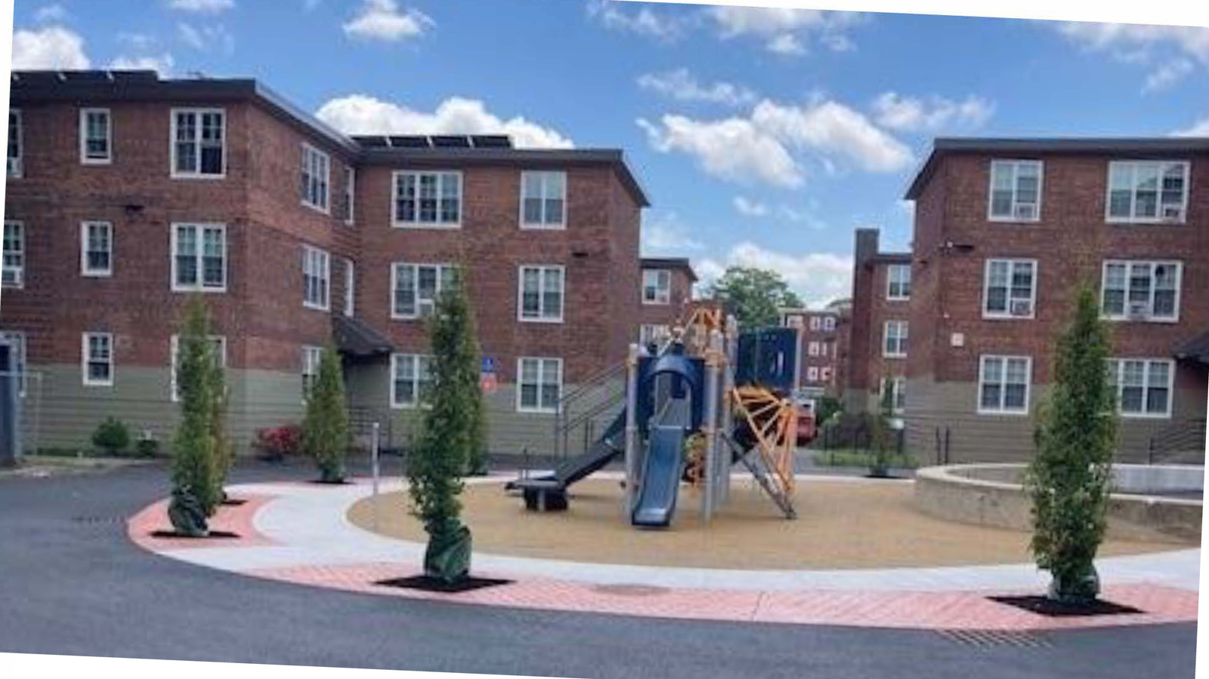


Resident Relocation: What Does it Mean for Your Redevelopment Projects?
Lenox Apartments - Boston, MA
Leefort Terrace - Salem, MA
FEC - Manhattan, New York
285 units
124 UNITS
2,056 units
RELOCATION REQUIREMENTS
  URA
RELOCATION REQUIREMENTS
  URA
RELOCATION REQUIREMENTS:
  URA, PACT, and RAD/Section 18 blend
FUNDING SOURCES
  BHA PBV Section 8 vouchers
  MassHousing First Mortgage
  Federal Low-Income Tax Credits
  Federal Historic Tax Credits
FUNDING SOURCES
  Section 8 PBV through Salem Housing Authority and DHCD​
  Federal and State Low Income Housing Tax Credits​ (LIHTC)
  DHCD Affordable Housing Trust Fund (AHTF), Housing Stabilization Fund (HSF), Housing Innovation Fund (HSF) and/or National Housing Trust Fund (HTF), American Rescue Plan Act (ARPA)​
  DHCD High Leverage Asset Preservation Program (HILAP)​
  City of Salem American Rescue Act Plan (ARPA) funds​
  Salem-Peabody Brownfields funds​
  Salem Community Preservation Act (CPA) funds​
  Home Investment Partnerships Program (HOME) funds​
  Mass Save Passive House rebates​
  45L Incremental Tax Credits​
  Solar Tax Credits​
  Deferred Development Fee​
  Project Based MRVP
FUNDING SOURCES
  PACT
  Federal Low-Income Tax Credits (LIHTC)

